Slide 1
GROCERY SHOPPING WEBSITE APPLICATION
TEAM MEMBERS(BATCH NO:21)
Vidyasagar R (211521205181)
Vigneshwaran M(211521205183)
Yeedera srimann raju(211521205188)
Yogesh R(211521205189)

Slide 2
ABSTRACT:
A grocery shopping web application streamlines the process of purchasing household groceries through an intuitive and user-friendly platform.
The application allows users to browse a wide range of grocery items, add them to a virtual cart, and securely complete purchases online. Users can also schedule deliveries or choose pickup options.
The application aims to enhance the shopping experience with an easy-to-navigate interface, seamless order management, and detailed product information, making grocery shopping convenient and efficient.

Slide 3
INTRODUCTION:
A grocery shopping web application is an online platform designed to simplify the process of purchasing groceries from the comfort of home.
It allows users to browse a vast selection of products, including fresh produce, packaged goods, and household items, all organized into categories for easy navigation.
Customers can add items to their shopping cart, apply discounts, choose preferred delivery or pickup options, and complete transactions using secure payment methods.

Slide 4
PROPOSED SYSTEM:
Browse and Search: Customers can explore a wide variety of grocery items, including fresh produce, packaged foods, and household essentials, using category-based browsing and advanced search filters.
Shopping Cart and Wishlist: Users can add products to a shopping cart for immediate purchase or save them in a wishlist for future reference.
User Accounts and Personalization: Registered users will have personalized accounts where they can view previous orders, track current orders, receive tailored product recommendations, and set delivery preferences.
Multiple Payment and Delivery Options: The application will support a range of payment gateways and allow customers to select convenient delivery or pickup options, ensuring flexibility.

Slide 5
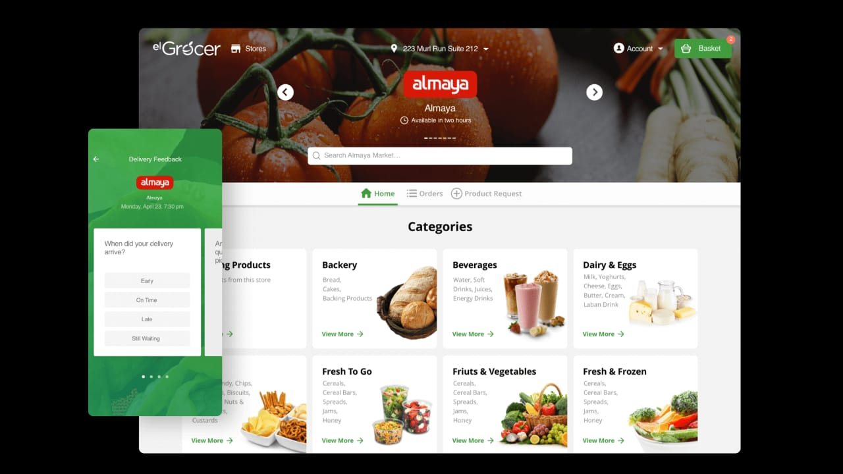
WEBSITE:

Slide 6
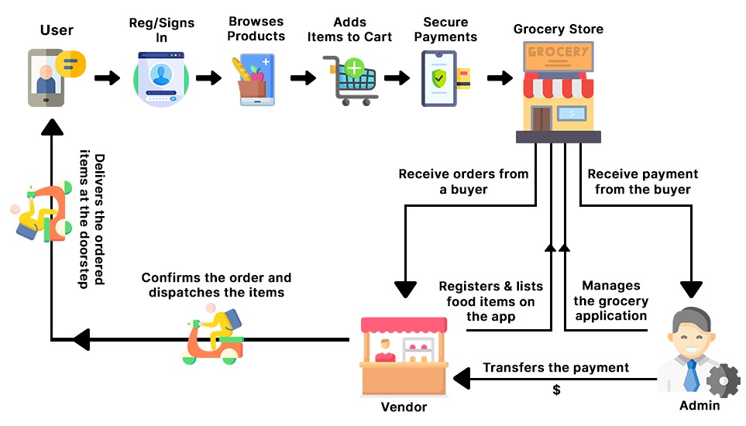
FLOWCHART:

Slide 7
CONCLUSION:
In summary, a grocery shopping web application offers a convenient and efficient way to shop for groceries online. It simplifies the shopping experience by providing easy browsing, secure payments, and flexible delivery options, all from the comfort of home. This system saves time, enhances user satisfaction, and meets the growing demand for digital solutions in everyday tasks.

Slide 8
THANK YOU

